Slide 1
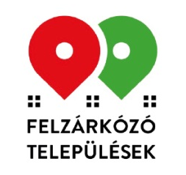
Emerging settlements programme
HRDOP Plus Programme
Zsófia Batta
Ministry of Interior
Prime-ministerial Commissioner’s Office
27.02.2023

Slide 2

The 300 most disadvantaged settlements
Settlements starting 2019-2022 and additional settlements to be included
Notes:
Átírhatom angolra, ha szükséges

Slide 3
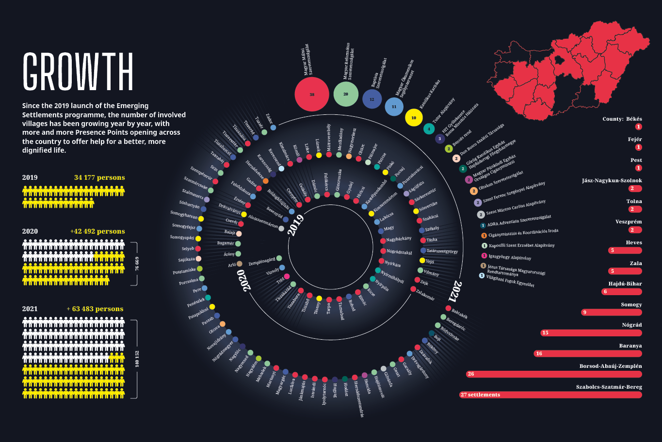

Slide 4
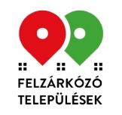
Strategic framework:
Hungarian National Social Inclusion Strategy 2030
In compliance with the new EU Roma Framework Strategy 2030 adopted in March 2021
Eligibility criteria for the actual use of EU funds for 2021-27
Objectives of the strategy and its measures:
  to reduce the rate of material and social deprivation, especially for the Roma population;
  to prevent the reproduction of poverty;
  equal opportunities for access to socio-economic goods
Specific chapter about the Emerging Settlements Programme

Slide 5
About the programme
Aimed at the least developed 300 settlements in Hungary
Selection: on the basis of a set of indicators measured by the Central Statistical Office (income, education level, unemployment, substandard housing and age structure, high number of children, crime level)
Antecedent: Children’s Chance Programme (ESF), Unlimited possibilities programme (ESF), Tiszabő-Tiszabura government programme (Hungarian budget)
Government decisions about the start and designation of the 300 settlement (1404/2019. (VII. 5.),1057/2021. (II. 19.))
310,000 people, 5,000 children are born per year in disadvantaged living conditions, employment and educational situation
Already 118 settlements are involved, from Spring 2023: 178 settlements
182 additional settlements selected in an open tender (results in March 2023)

Slide 6
About the programme
Key words:
  Presence
  Diagnosis based development: flexibility and responsiveness to local needs
  Complex, integrated approach: from conception to employment
  Partnership: religious and civic organisations
Financing:
  2019-2023: Hungarian budget
    2019: 31 settlements – 5.5 M EUR
    2020: 66 (+1) settlements – 11 M EUR
    2021: 118 settlements – 16,5 M EUR
  From 2023 onward: EU funds (RRF and ESF+, ERDF)

Slide 7
Elements of the programme
Presence-based social work, building up trust, crisis management
Interventions in the first 1000 days: promoting children's development, strengthening families, supporting nurses (tools, service, human support)
Innovative solutions to improve healthcare coverage: pediatric eye-sight screening bus using telemedicine devices, mobile medical clinic
Reducing housing poverty: averting life-threatening situations, „roof commando”, construction of standardised housing
Work socialization: garden programme, establishment of small workshops, labour market support
Community development, prevention with sport and music:
regular sessions, programmes, competitions

Slide 8
Some quantified results of the Emerging settlements programme
Work carried out in the involved settlements July 2019 - December 2022
Families reached | 28 440
Number of properties affected by intervention | 3 792
Number of residents assisted with housing intervention | 12 137
Number of families included in the small garden program | 5 922
Number of participants in children's activities | 26 353
Number of people involved in activities helping to find a job in the labor market | 5 074
Number of participants in sports activities | 9 175
Notes:
frissített

Slide 9
Emerging settlements programme in HRDOP Plus Programme – P8 Catching-up municipalities
Social innovation priority axis
According to the ESF+ regulation the EU has to support actions:
    with a socio-cultural component
    or strengthening bottom-up approaches
    based on partnerships involving public authorities, the social partners, social enterprises, the private sector and civil society
    the scaling up of innovative approaches tested on a small scale
    and member States shall dedicate at least one priority for social innovation
Amount of support:
    178 977 279 EUR (ESF+)
    22 342 857 EUR (ERDF)
Financing not linked to costs
Implementation period: 01.01.2024-06.30. 2029
Implementing organization: Hungarian Charity Service of the Order of Malta, involving other partner organizations
Notes:
FAGYI

Slide 10
HRDOP Plus
Programme elements of the project
Presence Points-related services and tools
Intensive social support during early childhood and complex support for increasing children's opportunities (First 1000 day and Nurse+ programme)
Improving living and housing conditions (Living and housing programme, Debt management, Financial integration support programme, Crisis fund)
Health program – eye-sight screening programme, mobile clinic
  Preventing early school leaving and increasing employability
  Crime prevention, drug prevention, victim assistance
Professional and methodological support
Community development (music, sport, roma culture, playing bus)
Notes:
EFOP Plusz: szociális kísérés, közösségfejlesztés, kora gyerekkori, egészségügyi beavatkozások

Slide 11
Priority indicators
Measure | Indicative resource framework | Name | Unit of measure | Milestone2024 | Target value 2029
ESZA+ l) | 178 977 279 EUR | Minorities (including marginalized communities such as Roma) | person | 10 000 | 75 000
 |  | Children under 18 years of age | person | 6 000 | 45 000
 |  | Number of people provided with health services | person | 5 000 | 30 000
 |  | Proportion of those admitted to secondary schools that award graduation | % | NR | increase
 |  | Changes in parental competence of parents of 0-3 year old children | % | NR | 10% increase
 |  | Live births under 2500 g as a % of all live births | % | NR | decrease
 |  | Number of undocumented absences of more than 50 hours in primary schools in full-time education |  | NR | decrease
 |  | The number of vulnerable minors per thousand residents of the same age | person | NR | decrease
 |  | Proportion of regular child protection discount recipients | % | NR | decrease
ERFA iii) | 22 342 857 EUR | Creation or development of Presence points (a building/part of a building accessible to the disadvantaged population, including a community space and a room suitable for receiving clients) | pcs | 238 | 300
 |  | Number of life-threatening repairs and minor renovations | pcs | 250 | 2 500
 |  | The number of persons reached by life-threatening prevention and minor renovations | person | NR | 7 500
 |  | The number of residents actually reached by the services provided by the Presence points | person | NR | 100 000

Slide 12




















Thank you for your attention!

