Slide 1
Guide to Social Impact monitoring and evaluation of social innovations
Authors: Ing. Dagmar Gombitová, PhD.
Mgr. Juraj Mikuš, PhD.
Bratislava, 27.07.2023

Slide 2
Cieľ
Methodological and application document
A tool for setting up a system for social impact monitoring and evaluation of social innovations
  a starting point for a comprehensive understanding of the topic
  selection of data collection methods
  establishing a system for the collection of evidence
  social impact analysis
Framework structure, tools and recommendations for collecting relevant data and evaluating the social impact of social innovations
It aims to enable the monitoring and evaluation of different initiatives with regard to their success, sustainability, potential scalability and replication

Slide 3
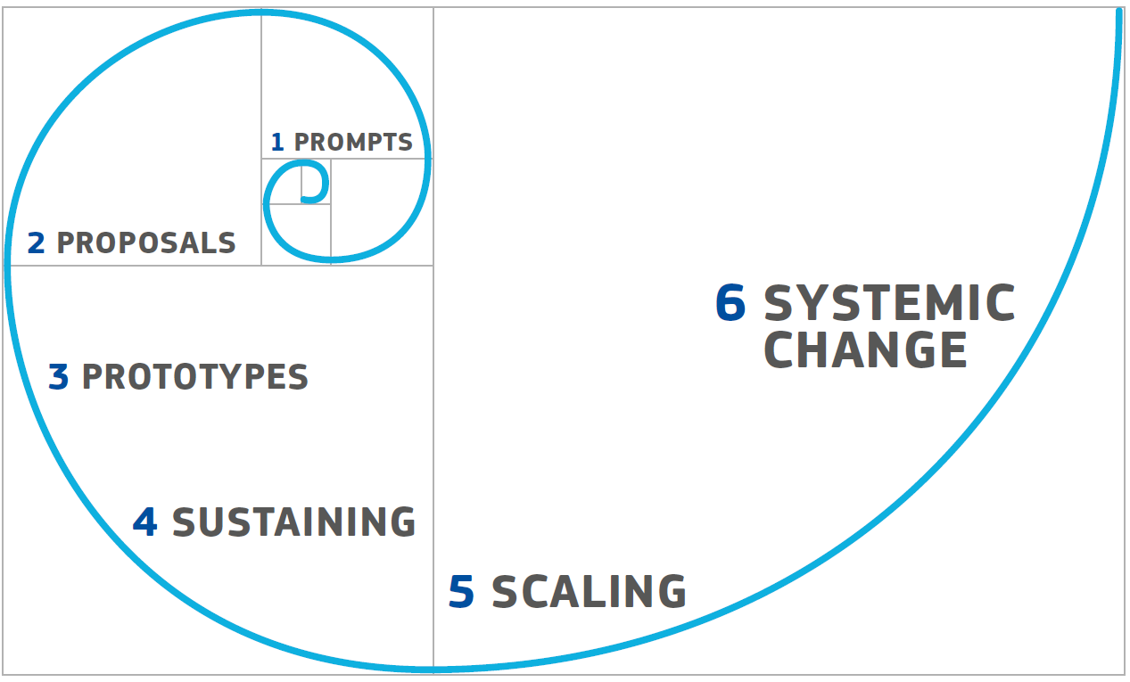
1. Social impact monitoring and evaluation in the context of social innovations and their scaling
Source: Murray a kol.(2010). The Open Book of Social Innovation. London: Nesta and the Young Foundation, p. 11.

Slide 4
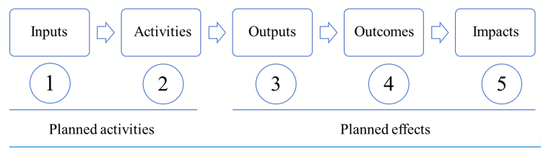
2. Theory of change as a basis for social impact monitoring and evaluation
Source: Own elaboration
Case study
Recommendations for logic model development

Slide 5
3. Monitoring social innovations at output level
Characteristics, objectives and steps for establishing a continuous and systematic monitoring process
Case study on monitoring outputs
Recommendations on monitoring

Slide 6
4. social impact evaluation of social innovations
4.1. Methods for evaluating social innovations
  Characteristics of the most commonly used methods for data collection and analysis
4.2. Process for setting evaluation indicators
  Procedure for selecting indicators and evaluation methods
  Case study on setting indicators and evaluation methods
  Recommendations for evaluation
Conclusion
Annexes

Slide 7
Thank you for your attention
Questions?

