Slide 1



MAPPING of the Eco-System for Social Innovation, Austria

Slide 2

SI – What does it mean?
AIM: A common understanding (base: Definition
ESF-Regulation)
Dimensions for Operationalisation:
  Novelty
  Social needs and societal challenges
  Approach and methods (focus on cooperation and participation)
  Aims and intensions

Slide 3
Characteristics ofSI

Slide 4
Role of the Target Group

Slide 5
Political Framework
National level - government programme (2020-2024): Just one mention (tax benefit for non profit-organisation and check of further funding of social innovation; Promotion of innovative projects in the field of soical enterprises and participation
Regional level: Just in two regions explicit reference to SI;
  Kärnten: Necessity of technological and social innovation
  Vienna: Smart-City-Concept and the necessity of social innovation
BUT: Open Innovation Strategy for Austria including social innovation with the aim to implement an open innovation platform for Social Innovation

Slide 6

Funding Structures
ESF+ SI as cross-cutting issue and as an own priority axe
ESF 14-20: no systematic embedding of SI, but an emphasis in priority equality between women and men as well as social inclusion → many projects, but no scaling-strategy
ELER/LEADER:
  Local Action Groups/Local Development Strategies on bottom-up approaches
  Development and expansion of important functions and structures for the common good (in the area of ​​services, local supply, regional learning and participatory culture)
  More than 800 projects since 2007
EFRE/INTERREG
  IWB/EFRE – no emphasis on SI
  INTERREG – social innovation not in each OP explicitly mentioned, but innovation a MUST → a lot of projects (without nearly any connex to ESF or LEADER)

Slide 7
National Fundings – some examples
SozialMarie: The first price for Social Innovation in Europe (2004): Each year 15 projects are awarded (financed by different private foundations, like ESSL Foundation)
Ministry for Social Affairs: Social Impact Bond and aws - Social Business Call
Some regional initiatives, e.g. Social Innovation Vienna – Social Projects with emphasis on neighbourly help
Austrian Research Promotion Agency (FFG):
  Social Crowdfunding
  Lighthouses for resilient cities in 2040
  Innovation.Rooms

Slide 8
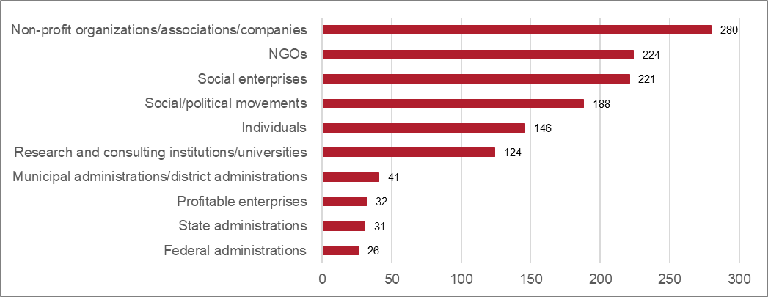
Relevant Stakeholders
Source: L&R Datafile 'Survey: Social Innovation in Austria', 2021 n=346 nmiss= 66; Question: Which actors provide the most important impetus for social innovation?

Slide 9
Projects: Focus of Action
Vocational orientation/ qualification/ coaching | 67 | 24%
Consulting/Support | 59 | 21%
Employment project | 39 | 14%
Inclusion/ non-discrimination | 24 | 8%
Sustainability/CO2-reduction | 17 | 6%
Communication / Participation / Housing | 17 | 6%
Neighborhood/citizen participation | 12 | 4%
Digital skills | 7 | 2%
Healthcare | 5 | 2%
Social Entrepeneurship | 5 | 2%
Development/Research | 4 | 1%
Other | 27 | 10%
Total | 283 | 100%
Source: L&R Datafile 'Survey: Social Innovation in Austria', 2021 n=346

Slide 10
Examples for projects I (voc.orientation / qual.)
Habibi und Hawara
private and independent training and integration program for people with a refugee or migration background (5 restaurants)
Discovering Hands
Early detection of breast cancer; new work area and job description for blind and visually impaired people
AUFLEB
Training, upgrading and placement of unemployed people

Slide 11
Examples for projects II (consulting/ support)
Neunerhaus - Mental health offer
A new service for homeless and uninsured people responds to the rise in mental stress
Specialisterne
Specialisterne Academy prepares people on the autism spectrum for their career path. Support in career orientation, development of individual strengths
Silver Girls
This education and counseling program aims at women from middle age who want to change careers or reorient themselves

Slide 12
Examples for projects II (employment projects)
Heidenspass
Low-threshold employment for young people: Upcycling social project, development and sale of products from used materials
Chancenforum autArK
Employment project for people with disabilities
Vollpension
generation café in Vienna, baking academy, older (retired) women bake and work in the cafe, they have additional income opportunities

Slide 13
Examples for projects: Others
Climatubers
Participatory video and digital storytelling to address climate-related inequalities, digital technologies to be connected to social action
SILC - Social Innovation Lab Carinthia / Social Innovation Vienna
Ideas competition, for innovative solutions with sustainable impact
Plaudertischerl
project of the Diakonie, the table is marked in the participating restaurants with a sign and you can simply sit at this table and communicate with others

Slide 14

Many thanks for your attention!
www.siplus.at

