Slide 1

ESF
Austria

Slide 2
Agenda
Overwiev
  General overwiev
  Priorities
Social Innovation

Slide 3
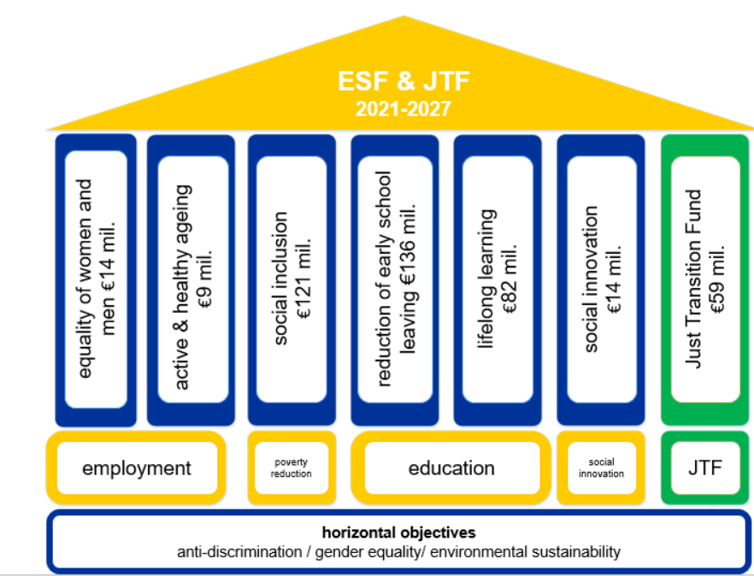
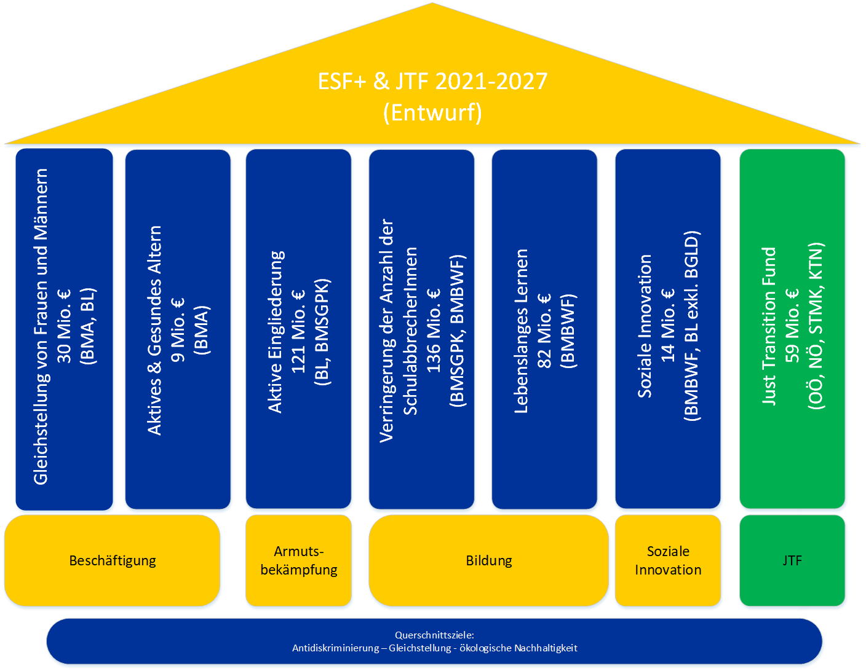
ESF & JTF
2021-2027
active & healthy ageing
€9 mil.
reduction of early school leaving €136 mil.
social inclusion
€121 mil.
lifelong learning
€82 mil.
social innovation
€14 mil.
equality of women and men €14 mil.
Just Transition Fund
€59 mil.
employment
poverty reduction
education
social innovation
JTF
horizontal objectives
anti-discrimination / gender equality/ environmental sustainability

Slide 4
1. Equality of women and men
measures | target groups | instruments
Approaches to reducing the gender income gap Promoting a better work-life balance Dismantling gender stereotyping | Enterprises (incl. non-profit social enterprises) Corporate bodies Individuals NGO Advice centres | Company-based approaches to promoting equal pay Approaches to improving the income situation of women Developing and implementing innovative approaches to promote a better work-life balance Develop and implement new approaches related to childcare facilities Development and implementation of approaches to promote gender-open career choice Campaigns and pilot projects for/with little-reached target groups

Slide 5
2. Active and healthy ageing
measures | target groups | instruments
Pre-project analyses and feasibility studies Counselling services for companies to cope with the specific challenges related to demographic change and the Scientific support for the (further) development of active ageing measures in the company and for employees 45+. | Businesses, especially SMEs Human Resources Employees 45+ | Analyses and feasibility studies Business advisory services Supporting studies

Slide 6
3. Combating poverty and promoting active inclusion
measures | target groups | instruments
Measures to support labour market integration and improve employability Support and stabilisation services in the run-up to labour market integration Active inclusion | People experiencing poverty Persons at risk of poverty People with disabilities | Clearing and orientation Consulting and coaching Qualification and promotion of qualification Employment measures Vocational orientation Counselling Support in the search for training and jobs Individual support on the workplace

Slide 7
4. Reduction of early school leaving & promote vocational education and training
measures | target groups | instruments
Measures in the school sector Measures for the transition from school/training to work | Pupils of the 9th and 10th grade in the field of vocational schools Pupils in a special form of secondary education Socially disadvantaged children in primary schools Pupils at risk of dropping out of secondary schools Pupils at risk of educational disadvantage in secondary schools Young people with disabilities or assistance needs from the 9th year of school attendance or from the age of 15 until the end of the 24th year of life | Individually designed support services with a focus on mathematics, living foreign language and compulsory subjects in subject theory In-school and out-of-school learning support and supervision Social pedagogical support Regional mobile psychosocial support for children and young people at primary schools and new secondary schools Support, care, accompaniment Coaching Individual support in the training and workplace Support and introduction to the labour market

Slide 8
5. Access to lifelong learning (incl. digital skills)
measures | target groups | instruments
Low-threshold, high-quality guidance on education and careers for adults Basic education Offers to catch up on the compulsory school leaving certificate Standards for adult educators and counsellors | educationally disadvantaged persons, low-skilled workers People with a migration background People at risk of marginalisation Socially and regionally disadvantaged persons Older persons Responsible for the offer, Trainers, Advisors Multipliers | Target group-oriented and provider-neutral educational guidance networks Basic education offers for the acquisition of relevant competences Offers to catch up on the compulsory school leaving certificate Qualification measures and tools (incl. online formats)

Slide 9
7. JTF
measures | target groups | instruments
Measures for targeted career guidance and counselling, activation and support, information and industry presentation, survey of needs and development opportunities in the region Measures for training, further qualification, retraining and/or expansion of professional skills Measures to broaden skills and strengthen opportunities in the labour market through employment projects | Employees Long-term unemployed/unemployed Jobseekers Young people Women Company/employer Schools, Training centres Socio-economic enterprises (SÖB) | Establishment of a counselling system for companies and employees Survey of needs at company level Proactive career and qualification guidance Active preparation for (re-)entry into the labour market Targeted information and advisory services that include the green sector in particular. Training opportunities Further qualification offers Retraining offers ....

Slide 10
6. Social Innovation
covers 2 specific objectives
promoting lifelong learning fostering active inclusion
measures | target groups | instruments
Social innovation | Enterprises (incl. non-profit social enterprises) Corporate bodies Individuals NGOs and counselling services Civil society actors | Radical innovation Incremental innovation

Slide 11
II. Social Innovation
2 specific objectives
promoting lifelong learning | fostering active inclusion
promoting lifelong learning, in particular flexible upskilling and reskilling opportunities for all taking into account entrepreneurial and digital skills, better anticipating change and new skills requirements based on labour market needs, facilitating career transitions and promoting professional mobility | fostering active inclusion with a view to promoting equal opportunities, non-discrimination and active participation, and improving employability, in particular for disadvantaged groups

Slide 12
How is the ideal process of a call in SI?
Tasks of the IB
Tasks of the applicants
Support by SIplus

Slide 13
Ideal process for SI-project implementation
Call SI
Incremental or radical
Expert opinion
Supplement/Submission of additional Documents
Internal/ external assessment
Decision: rejection or confirmation
If confirmed: funding agreement
Project implementation
Support from SI Plus
Supportfrom SI Plus
Supportfrom SI Plus
Support from SI Plus

Slide 14
Concerns of the IB
Low financial resources = a lot of effort with little output
What happens when auditors say something is not innovative?
"Failure is allowed" could lead to implement projects not in compliance with the contract and no possibility for the IB to intervene

Slide 15
Potential tasks of the SI Centre
Contact point for all Austrian ESF stakeholders
Support service of the IB
Development of a catalogue of criteria
Organizes mutual learning and breaks down research results into practical approaches and tools for practitioners
Support for upscaling
Raising awareness of the social innovation concept

