Slide 1
ESF+ support to Social Innovation
COM update
SIPlus Steering Committee Meeting
12 Oct 2022 Bratislava
Michael GROSSE, European Commission

Slide 2
News from ESFA
Partnership agreement with ESFA to be signed in October 2022
First call to be launched swiftly thereafter:
  ALMA – EUR 15m
  Social inclusion and participation of young people / NEETs & skills – EUR 7m
  NCC support – transnational projects – EUR 8m
  Social inclusion of refugees – EUR 22m

Slide 3
Overview of programming SI within the ESF+
Most Member States foresee a dedicated priority on social innovation in one ESF+ programme.
4 Member States indicate that more than one ESF+ programme will have a dedicated priority on social innovation: FR and IT foresee 2, BE 3 and DE 8.
AT, HR, FR, IT, SI and SE indicate that their respective ESF+ programme(s) mention social innovation also outside the dedicated priority/ priorities.
State of play 05/2022 covering all MS except EL, LV, LT and ES

Slide 4
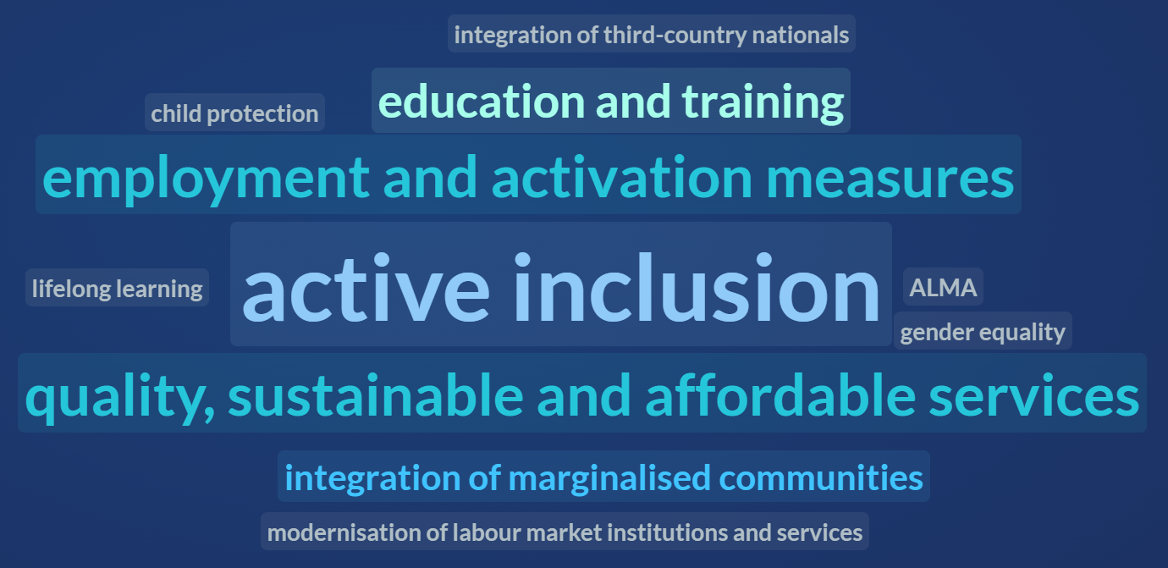
Thematic focus of the dedicated priority/ priorities

Slide 5











Budget allocation for the dedicated priority/ priorities
0,99%
0,41%
0,37%
3%
2,08%
1,93%
1,77%
1,37%
1,35%
4,99%
4,79%
4,5%
4,09%
3,96%
3,52%
3,25%
0-1%
1-3%
3-5%
Notes:
Budget allocations for the dedicated priority on social innovation were calculated based on (draft) numbers provided by the geographical desks of DG EMPL in proportion to the 2021-2027 ESF+ initial allocations by country in current prices using the following data source: Copy of 2021-2027 ERDF and ESF+ initial allocations (current prices) | Data | European Structural and Investment Funds (europa.eu) (accessed 25/04/2022).

Slide 6
Some other elements…
Replication/ scaling-up of social innovation
mentioned by BE, BG, HR, CY, CZ, FI, FR, EL, HU, IR, MT, NL, PL and SE.
National Competence Centres
mentioned by AT, BG, CY, DK, FI, EL, IR and SK.
Transnational cooperation and social innovation
mentioned by AT, BE, BG, HR, CY, FI, DE, NL, PL, SK and SE.

Slide 7
Contact
Risto Raivio, Senior Expert, Unit G.1. European Social Fund+, Directorate-General for Employment, Social Affairs and Inclusion, European Commission
Risto.Raivio@ec.europa.eu
Laura Mangeng, Policy Assistant, Unit G.1. European Social Fund+, Directorate-General for Employment, Social Affairs and Inclusion, European Commission
Laura.Mangeng@ec.europa.eu
Michael Grosse, Policy Officer, Unit G.1. European Social Fund+, Directorate-General for Employment, Social Affairs and Inclusion, European Commission
Michael.Grosse@ec.europa.eu

Slide 8
Thank you

