Slide 1
Czech Competence Centre
for social innovations
Petr Havlíček
Social Innovation Unit
Ministry of Labour and Social Affairs

Slide 2




ABOUT US
Pan-European Social Innovation Lab (PEnCIL)
Ministry of Labour and Social Affairs, Social Innovation Unit
Project manager, evaluator, coordinator of CC

Slide 3
INTERVIEWS IN NUMBERS
4
interviewers
22
hours of interviews
92
minutes
(average interview lenght)
Notes:
65 % of women
35 % of men

Slide 4

MAPPING OF ECOSYSTEM OF SOCIAL INNOVATIONS
Barriers and challenges
  Risk aversion
  Excessive hierarchy
  Lack of long-term vision
  Insufficent pro-client approach
  Insufficent innovation approaches (design thinking, testing, evaluation, evidence-based/informed decision)
  Focus on public administration as a crucial stakeholder

Slide 5
TRANSNATIONAL SCALING-UP PROJECTS
Papillon
  Meeting with Bosch
  NO RENT the appliances, just SELL them to NGO with a significant discount
  Realizator Department of Innovation projects
  Will be funded by ESF+ (incubation call)
  Friday 14/10 consultation of project proposal
Cokido
  Found appropriate NGO Rodina v klidu
  First consultation (very poor project proposal)
  New project manager connected with belgian Cokido
  Consultation of project proposal in Ocotober

Slide 6
ACTIVITIES OF CZECH COMPETENCE CENTRE
Workshops and seminars
  Communication of public administration
  Inspections/controls in public services
  Social work in municipalities
Long term cooperation
Ministry of Justice
  Information for debtors
  ESF project (Through insolvency together)
  Service design
Cooperation on strategy of social inclusion
  Strategy as process not only document
  Remove barriers between stakeholders
  -> outputs for our blog
Notes:
Communication
3 cases from ESF+ and how to communicate them (remove ESF language, provide results through stories
Inspections
Formalism (quality standard) over real needs (communication style, paternalistic x partnership approach etc.)
Social work
Ministry Unit responsible for guidance towards social workers
Impact of social workers, support of their role -> output the smallest possible experiment

Slide 7


Slide 8
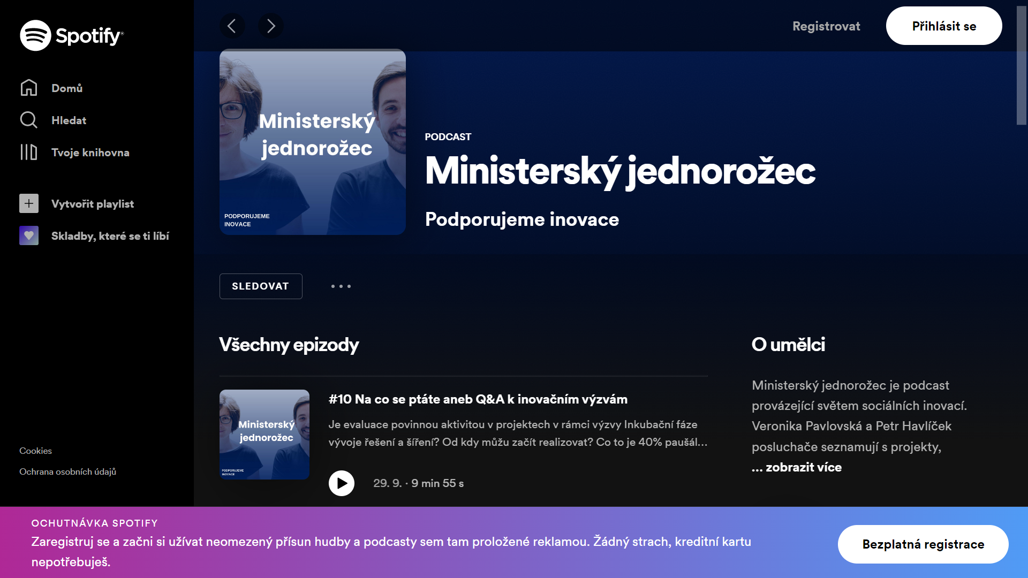
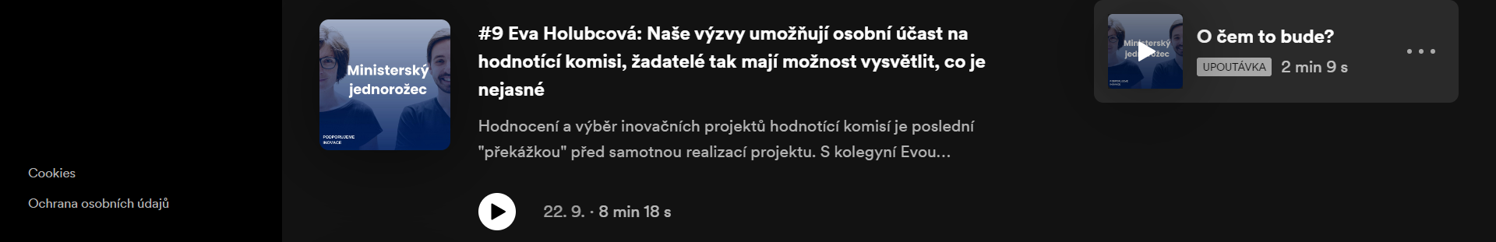

Slide 9
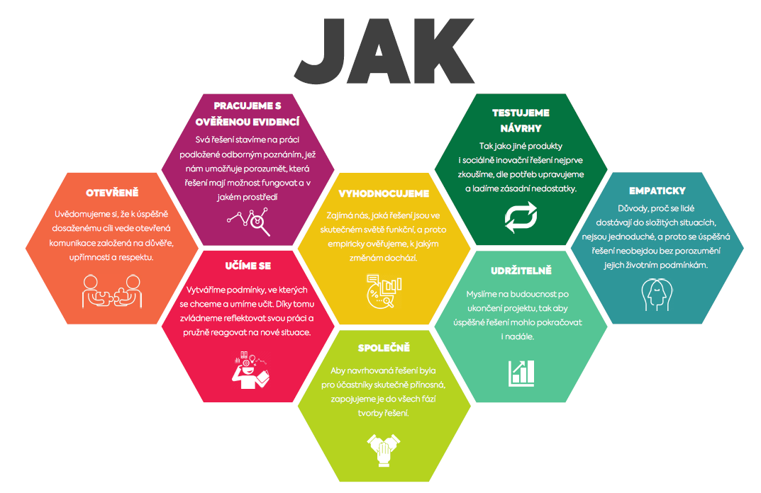

Slide 10
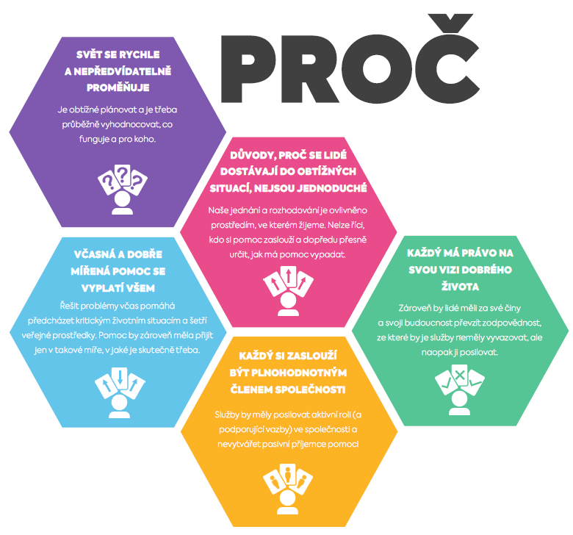

Slide 11
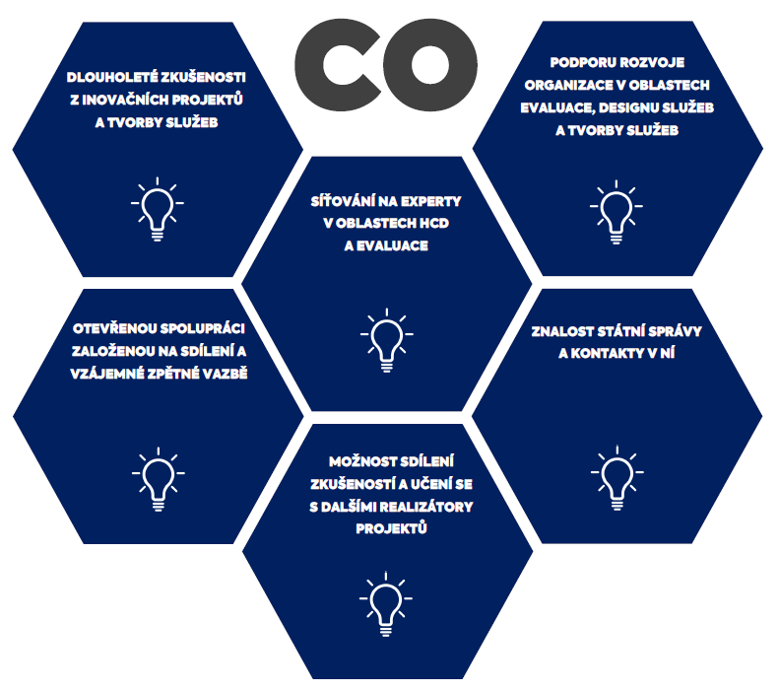

Slide 12
SCHEDULED ACTIVITIES
Workshop on behavioral insight (December)
Workshop with Asylum Houses (sharing good practice within current legislation)
Social Innovation Forum (February)
  international
Workshop on Human learning systems (TBA)

Slide 13

Thank you for your attention
Petr Havlíček
Social Innovation Unit
Ministry of Labour and Social Affairs
petr.havlicek@mpsv.cz

